Slide 1
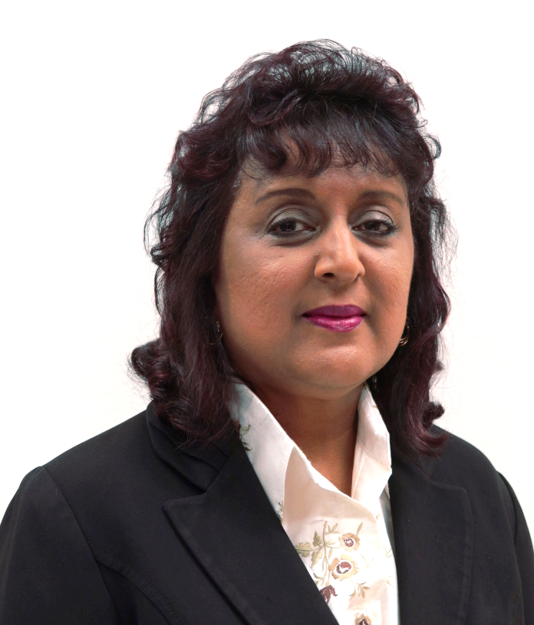
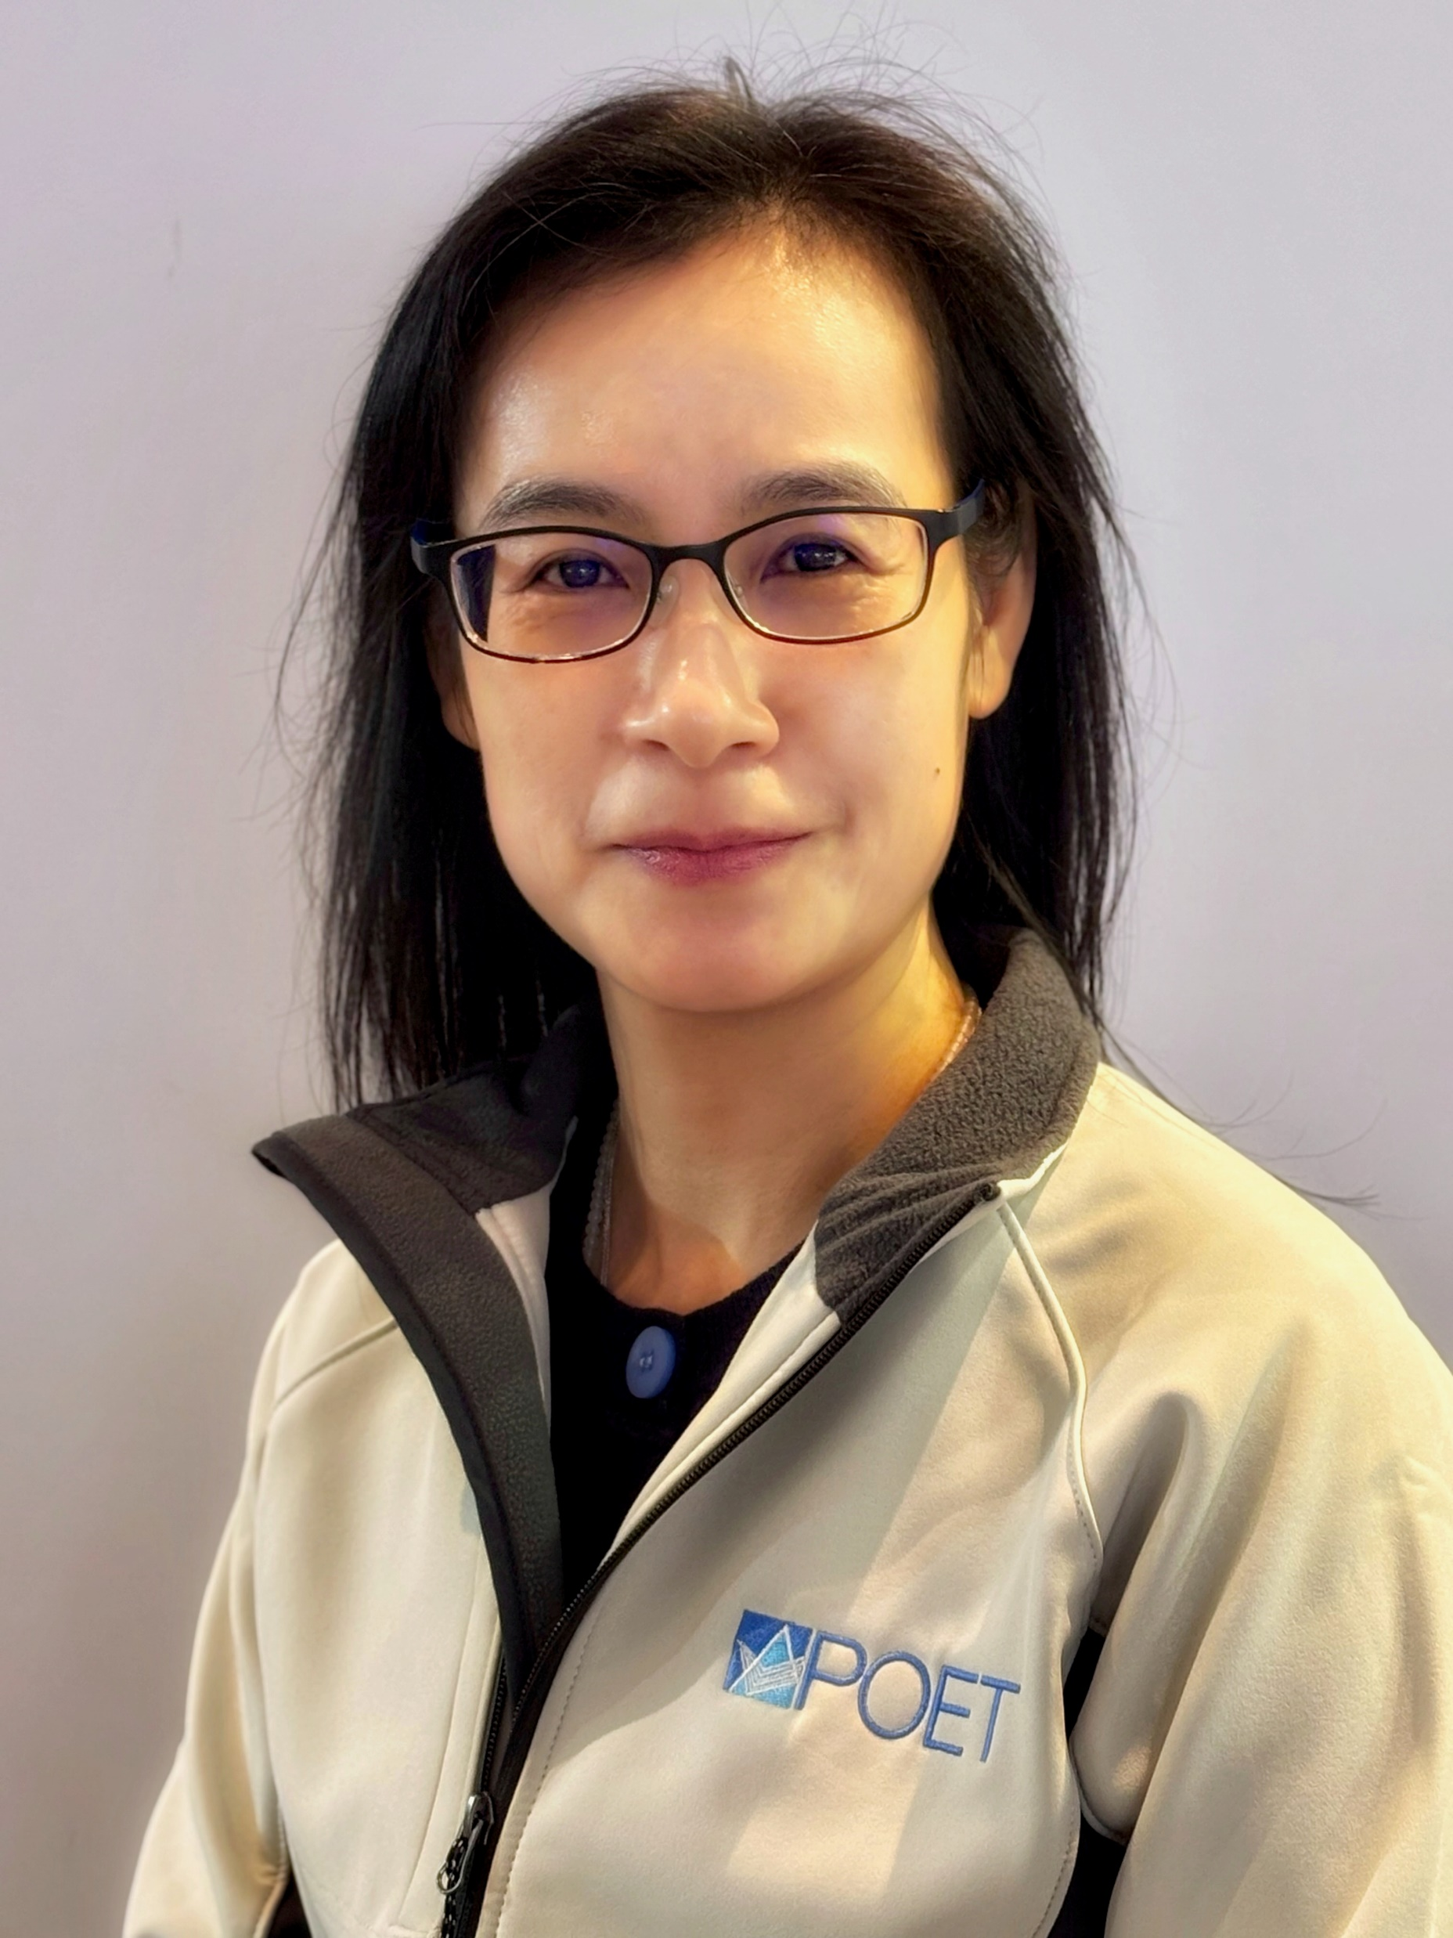
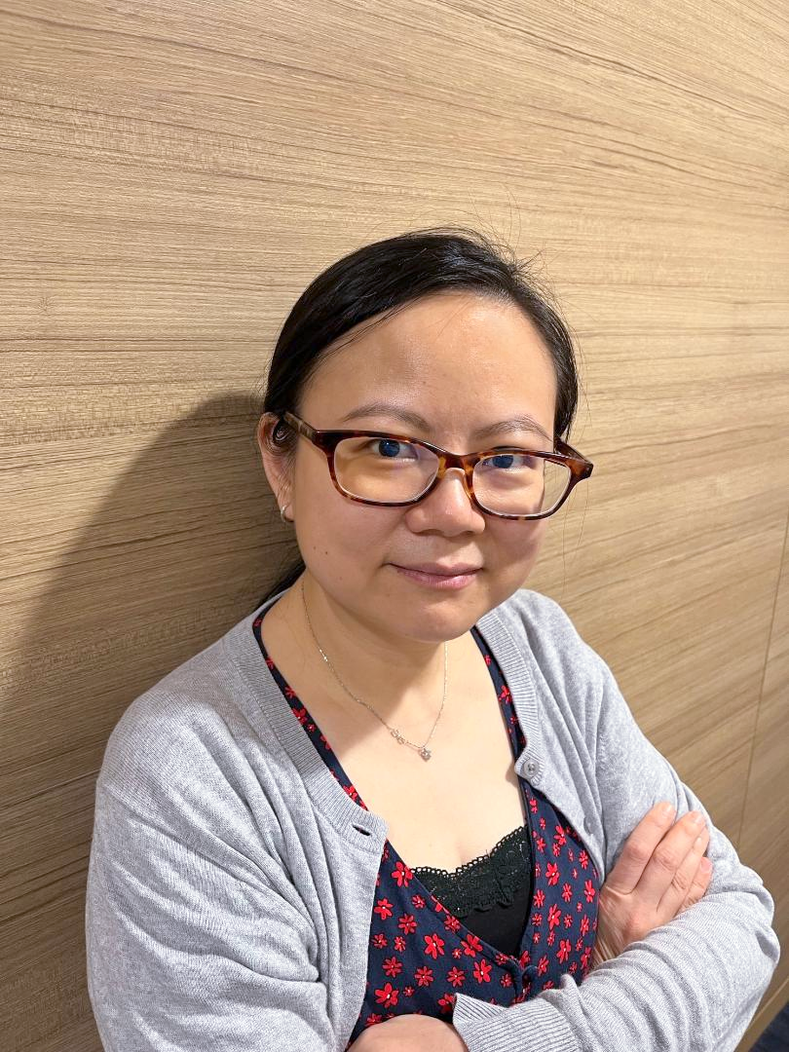
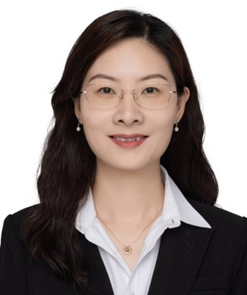
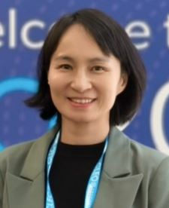



Women in Sensors and Photonics
Prof. Malini Olivo, F.SNAS, F.AIMBE, F.Optica
Distinguished A*STAR Fellow,
Distinguished Principal Scientist, Skin Research Labs (A*SRL), A*STAR
Dr Mo Jinyu
SVP & GM, Asia at POET Technologies
Dr Doris Ng
Principal Scientist, Institute of Microelectronics, A*STAR
Prof. Liu Huanhuan
Associate Researcher at the Shenzhen Institute of Advanced Technology (SIAT), Chinese Academy of Sciences
Moderator: Dr Hu Juanjuan Dora
Principal Scientist, Institute for Infocomm Research, A*STAR
930-1100: Invited talks
Medtech and nano-biophotonics and its applications in translational medicine
Photonics Integration for a New Generation of AI Computing and Data Center Communications
Gas Sensors for a sustainable society
Specialty Fiber-based High Sensitivity Distributed Acoustic Sensing Technology
1100-1130: Panel discussion and Q&A session
1130-1400: Networking lunch
Date Time Venue | 14 Nov 2025 (Friday) 9.30 AM – 2.00 PM NUS E7-03-09 (Seminar Room 4) 15 Kent Ridge Cres, Singapore 119276
Co-Organized by:
Supported by:

