Slide 1
Education and Career in Semiconductors

Slide 2
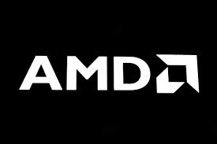
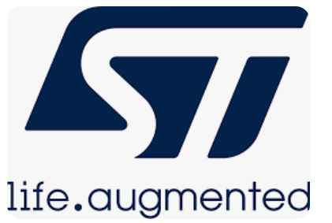
About Me
Simran Khokha - M.Sc. Integrated Circuit Design (NTU, Singapore and TUM, Germany)
Product Development Engineer – 2018, AMD Singapore
Design Engineer ( Verification ) – 2019 – 2023, Realtek, Stmicroelectronics Singapore
Product Management and Marketing – 2024, Infineon Germany

Slide 3
Overview
Wondering whether the roles in semiconductor industry is for you? Want to know more about the roles that exist in this space? Confused about where you would fit in best?
This section will provide you with an introduction to the semiconductor industry, the potential reasons to make a career in this sector and the Education that you could take up to pursue such path.
The objective is to provide you with the information that can help you make a decision on whether this is a space that you would like to work in

Slide 4
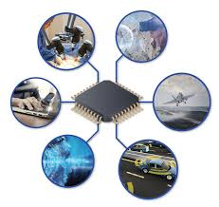
What Comprises of Semiconductor Industry and why should you work here?
Expected revenue of 550 Billion USDin 2024 ( Fun Fact: this no. Equal to the GDP of the country of UAE)
Additional demand of 1 Billion Skilled workers expected by 2030
Various Businesses in the semiconductor space – 5G, autonomous cars, artificial intelligence (AI), the Internet of things, optoelectronics and sensors

Slide 5
Frontend Vs Backend

Slide 6
Frontend Vs Backend Job Roles
Frontend
Backend
System Specification Engineer: Gathering requirements and understanding the application to create a chip specification.
System Architect: Defining the chip's architecture and its major functional blocks.
RTL Design Engineer: Implementing the design using HDL, creating Register-Transfer Level (RTL) code.
Functional Verification Engineer: Ensuring that the chip functions as expected using simulation and testbenches.
Synthesis/STA Engineer: Transforming RTL code into gate-level descriptions for physical implementation.
Design for Testability Engineer: Adding features to make it easier to test the chip once it's manufactured.
Physical Design: Placing and routing transistors, gates, and interconnects to create the chip layout.
Process Engineer: As a Process Engineer, you will be responsible for sustaining and making the improvement efforts to yield and equipment performance in your process area, to achieve high device yield, reliability, and cost efficiency. You have to establish processes, set up parameters, and carry out evaluation to improve process and equipment performances.
Product Engineer: Responsible for new product startup and yield improvement, Support design verification and in-depth circuit of new products using CAD tools and Verilog simulations. Work with the wafer fab process/integration group to address processrelated defects affecting product yield. Identify design marginalities and recommend design fix for circuit-related problems
Process Integration Engineer: Design, execute, and analyze experiments to improve fab process, yield, and quality.Collect and interpret complex data to optimize Fab processes and increase yields.Collaborate with other PI module owners and sister fabs to drive business process alignment. Partner with IE, PEE and Production to better forecast and balance yield, output and process issues.
Notes:
Front-end VLSI design involves the initial stages of integrated circuit development. Designers in this phase are responsible for conceptualizing and specifying the functionality of the chip. This includes understanding the application of the chip, defining its architecture, and creating a high-level design. Front-end designers typically work with hardware description languages (HDLs) like VHDL or Verilog to create a detailed functional description of the chip.
Back-end VLSI design, on the other hand, focuses on the physical implementation of the chip. It encompasses translating the logical design into a layout that can be manufactured. Back-end designers work with tools for physical design, placement, routing, and manufacturing processes to ensure the chip meets its performance, power, and area (PPA) requirements.

Slide 7
Frontend or Backend? What to choose?
Interest and Aptitude
Technical Skills
Problem-Solving Approach
Industry Demand
Career Growth and Long-Term Goals
Work Environment and Culture
Learning and Adaptability
Notes:
When deciding between VLSI front-end and back-end design, several factors should be taken into account:
1. Interest and Aptitude: When choosing between front-end and back-end design, consider your interests and aptitudes. If you are passionate about logical design, algorithms, and have a strong software development background, front-end design may be a better fit for you. On the other hand, if you enjoy solving physical design challenges, optimizing for manufacturing, and have a strong understanding of semiconductor physics, back-end design might be your calling.
2. Technical Skills: Evaluate your technical skills and knowledge. Front-end designers need proficiency in languages like Verilog, VHDL, and strong knowledge of digital design concepts. Back-end designers require skills in physical design tools, understanding of manufacturing processes, and signal integrity analysis.
3. Problem-Solving Approach: Assess your problem-solving approach. Front-end designers often tackle abstract, logical issues, while back-end designers deal with concrete, physical constraints. Your preference for abstract or concrete problem-solving can guide your choice.
4. Industry Demand: Research the industry demand for both roles. The demand for VLSI professionals varies by region and specialization. It's crucial to align your choice with job opportunities in your preferred location.
5. Career Growth and Long-Term Goals: Consider your long-term career goals. Front-end designers may find opportunities in areas like architectural design or system-level integration, while back-end designers can advance to roles in physical design management and manufacturing.
6. Work Environment and Culture: Assess the work environment and company culture. Front-end and back-end designers may work in different teams and have distinct work cultures. It's essential to find an environment that matches your preferences and values.
7. Learning and Adaptability: The semiconductor industry evolves rapidly. Assess your willingness to adapt and continuously learn. Both front-end and back-end designers must stay updated with the latest technologies, but the specific skills required may vary.

Slide 8
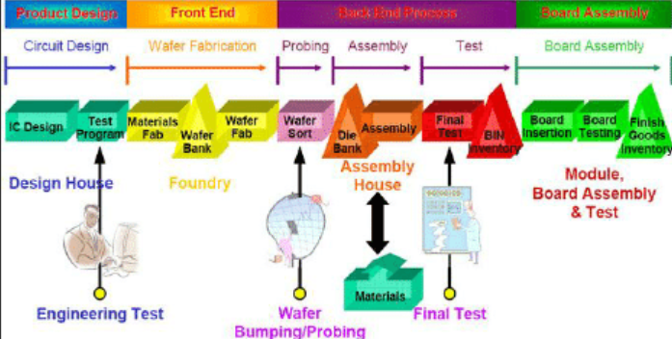
Semiconductor Life Cycle

Slide 9
Measurable Skills Required

Slide 11
Education for Semiconductor job roles
Major | Description | Key Subjects | Career Prospects In Semiconductor Industry
Electronics and Communication Engineering (ECE) | Focuses on electronic circuits, communication systems, and related technologies. Directly aligned with semiconductor industry. | – Digital and Analog Electronics – Microprocessors and Microcontrollers – Signal Processing – Communication Systems – VLSI Design | – Chip Design and Manufacturing – Communication Systems Development – Quality Control and Testing – Research and Development
Electrical Engineering (EE) And/Or Electronics Engineering (EE) | Covers a broad range of topics related to power electronics, and electromagnetism, crucial for semiconductor devices. In many countries, ECE is often termed as EE. | – Circuit Analysis – Control Systems – Power Electronics – Electrical Machines – Electromagnetic Theory | – Semiconductor Manufacturing and Process Engineering – Chip Design And Manufacturing – Design and Maintenance of Power Systems in Plants – Equipment and Tool Development
Material Science and Engineering | Study of materials used in semiconductor manufacturing. Focus on properties, performance, and processing of materials. | – Thermodynamics of Materials – Physical Metallurgy – Polymer Science – Ceramics – Nanomaterials | – Material Research and Development – Quality Analysis in Manufacturing – Process Development for New Materials
Computer Engineering | Combines electrical engineering and computer science, focusing on computer systems and software for semiconductor design. | – Computer Architecture – Operating Systems – Algorithm Design – Embedded Systems – Digital System Design | – Software Development for Semiconductor Devices – Embedded Systems – Chip Design and Testing – System Integration – Product Engineering

Slide 12
Nanotechnology | Deals with structures and devices at the atomic and molecular scale, enabling advancements in semiconductor technology. | – Nanochemistry – Quantum Mechanics – Nanofabrication – Nano-scale Electronics – Molecular Engineering | – R&D in Advanced Technologies – Nanoscale Manufacturing Processes – Innovation in Fabrication Techniques – Quality Control and Testing at Nanoscale
Mechanical Engineering (With Focus On Microelectronics) | Application of mechanical principles to the design and manufacture of microelectronic systems in semiconductor devices. | – Mechanics of Materials – Thermodynamics – Microfabrication Technology – Fluid Mechanics – Heat Transfer | – Design and Manufacturing of Equipment – Thermal Management in Devices – Microelectronic Packaging and Reliability Analysis – Process Engineering in Fabrication
Chemical Engineering (With Focus on Semiconductor Processing) | Focuses on chemical processes and materials in semiconductor manufacturing, crucial for fabrication processes. | – Chemical Process Principles – Semiconductor Materials and Processes – Surface and Colloid Chemistry – Nanotechnology in Chemistry | – Fabrication and Processing – Material Development for Devices – Quality Control in Chemical Processes – R&D in Semiconductor Materials
Photonics Engineering | Centered around the use of light in technology, highly relevant to optoelectronics and fiber optics in semiconductors. | – Optics and Lasers – Optical Fiber Technology – Photonic Devices and Systems – Quantum Electronics | – Development of Optoelectronic Devices – Fiber Optics Communication System Design – Research in Photonic-based Technologies – Quality Testing and Control in Applications
Industrial Engineering | Focuses on optimizing complex processes and systems, crucial for improving efficiency and productivity in semiconductor manufacturing. | – Operations Research – Systems Engineering – Production Planning and Control – Quality Control – Supply Chain Management | – Process Optimization in Semiconductor Manufacturing – Supply Chain Management for Semiconductor Products – Quality Assurance and Control – Production Planning and Management – Systems Analysis and Design

Slide 13
Global Skills shortage in Semiconductor Industry

Slide 14
Exploring Semiconductor Industry Abroad: Things to keep in mind
Job opportunities
Work Culture
Language Barriers
Education
Visa
Growth

Slide 15
Questions?

