Slide 1
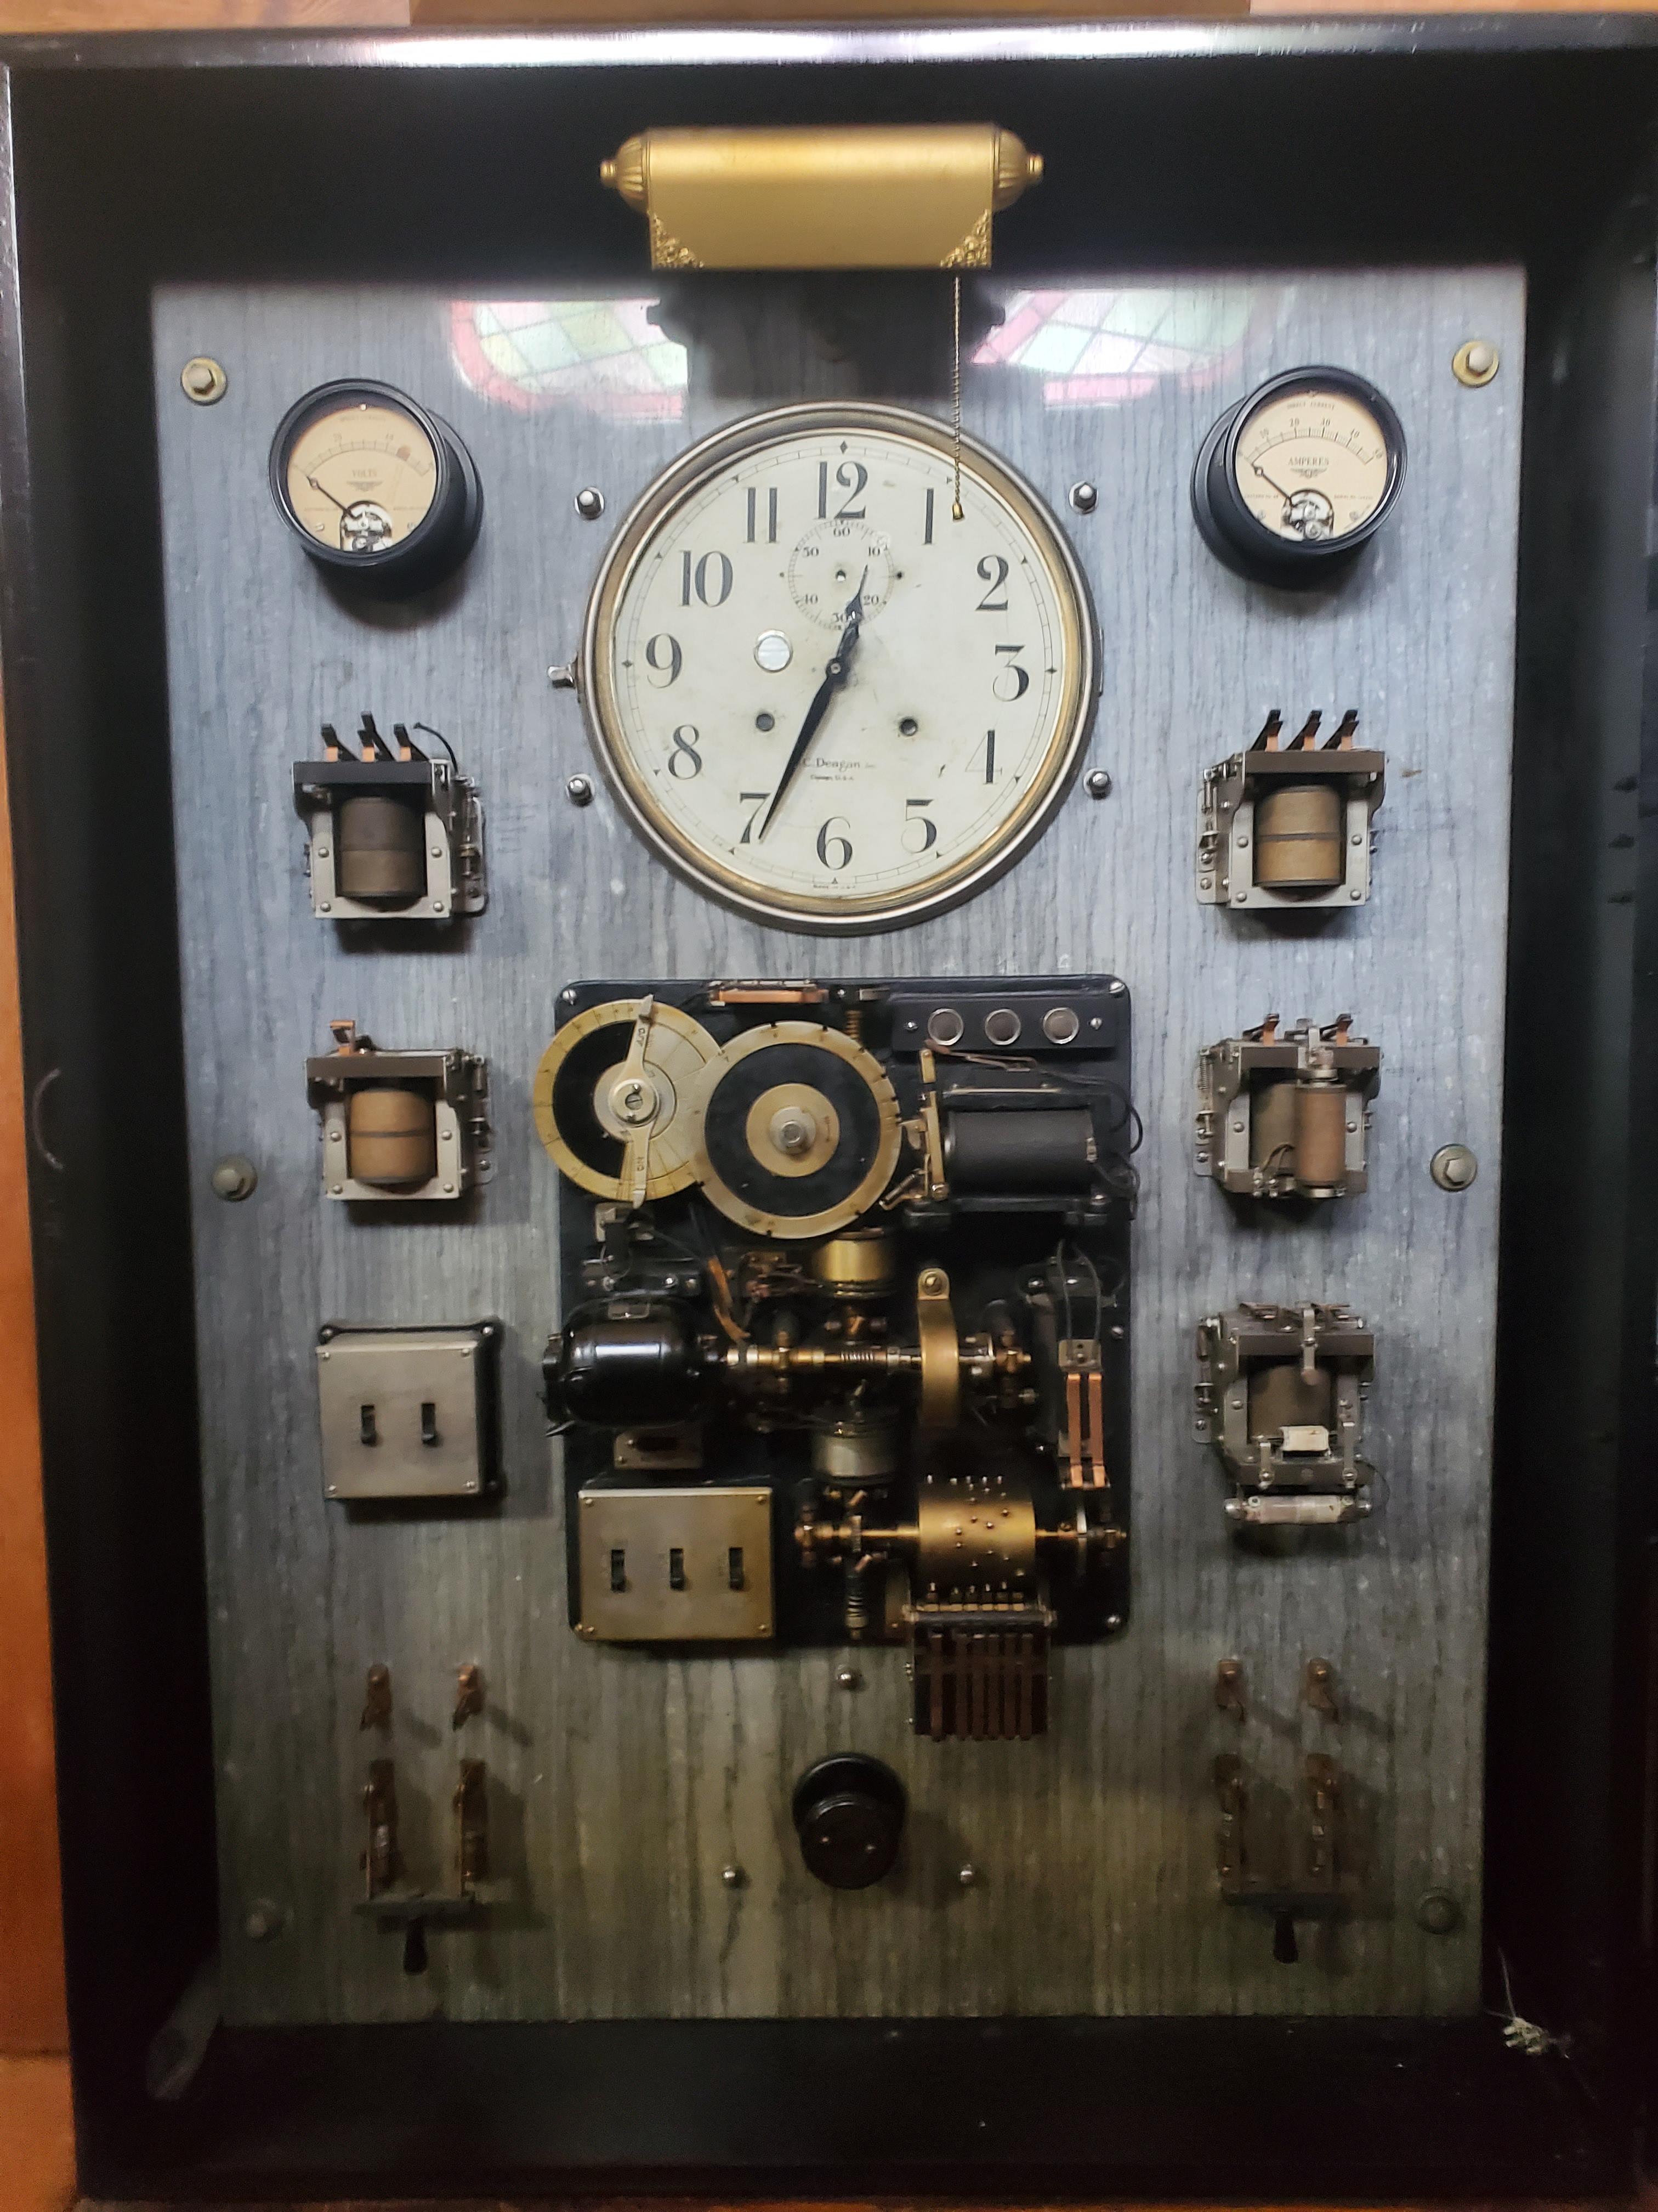
David Mann FIET, C.Eng(UK), LSMIEEE
FROM IDEA TO EMPIRE
NAVIGATING THE ENTREPRENEURIAL JOURNEY

Slide 2
What is the need for Entrepreneurs?
“What we need is an entrepreneurial society in which innovation and entrepreneurship are normal, steady and continual
Peter F. Drucker
Austrian American management consultant, educator, and author

Slide 3
Entrepreneurship? What?
Stephenson’s Working Definition of Entrepreneurship
“The process by which individuals – either on their own or inside organizations – pursue opportunities without regard to the resources they currently control”

Slide 4
Entrepreneurship- My experience?
My industrial experiences
I have led businesses that have pioneered new technologies in no less than seven countries
Optical communications, starting before that but really getting established in the early 1980’s.
Multi-service data products within a telecommunications company in early 1980’s
Led the introduction of Software and Computing into telephone switches in 1974
Led the introduction of microprocessors into telecommunications products in the early 1980’s
In each of these adventures I had to fight for resource, for funding and for a community of belief.
Mobile Wireless communications in 1977 when everybody thought we were simply crazy

Slide 5
What about you?
You may already consider yourself to be an Entrepreneur
You may be left unemployed and are feeling that now is the time to risk all and be your own master?
You may be somewhere in between or a person that has previously tried this and it didn’t work out.
You may work in a large stable digital age company and think there is no place for entrepreneurship.
You might be thinking about giving it a go?
“I Just want to learn”.

Slide 6
USA and Canada
What does the data say?
In the USA a new enterprise is created every 6.3 seconds
The US census bureau in 2023 reported that over 5 million new companies were created
Note that in times of economic duress this can rise significantly (between 18 & 20%) (Post Pandemic)
In times of duress some magnificent companies have been created (FedEx (oil crisis 1973))
US Entrepreneurs cautiously optimistic about job creation – but have some concern arising over slowing economy, inflation and investor caution.
In Canada there are signs of reducing levels of entrepreneurship
From the BDC report (Fall 2023)
1.3 entrepreneurs per 1000 in 2022 compared with 3 entrepreneurs per 1000 in 2000.
From Stats Canada Reports:
Still around 1million entrepreneurial companies in Canada, with about 100,000 created each year
Entrepreneurship is a vital component in the USA, Canada and World economies

Slide 7
Let’s Clarify the Terminology!
Entrepreneur Individual
Entrepreneurship Process
Entrepreneurial Attitudes, skills
and behaviors
Entrepreneurial Ecosystem Role of society
I will come back to these later in discussion because whilst they are often
Commonly used to mean the same thing…..THEY ARE NOT

Slide 8
If you want to be an entrepreneur --
My recommendations
Take
Strive
Always strive for Effective Outcomes and make an impact
Know
Know your value proposition
Leverage
Leverage Technology as an Enabler
Understand
Understand that Customers are your best allies
Build
Build your personal support network
Take part in an Entrepreneurial Ecosystem

Slide 9
So What is an Entrepreneurial Ecosystem?
Entrepreneurs who aspire to start and grow new businesses, and the people who support entrepreneurs.
Talent that can help companies grow.
People and institutions with knowledge and resources to help entrepreneurs.
Individuals and institutions that serve as champions.
Stories that people tell about themselves and their ecosystem.
Culture that is rich in social capital –makes the ecosystem come alive by connecting all the elements together.

Slide 10
Entrepreneurs strive for Effective Outcomes that make an Impact!
Signs of successful Entrepreneurial Activity
Be able to articulate your value proposition and business goals
Show no doubts but never lie
Respect your ecosystem members
Give good feedback to your stakeholders --- all the way.
Don’t dismiss other’s ideas too readily…be a good listener
Your attitude leaves an indelible mark about you.
Establish how you will measure success
Then ask yourself “Do others align with my measure?”
My stakeholders?
My team?
Know how and what data you need to measure progress
Do your stakeholders align with this?
Make this clear and outside in
Being an entrepreneur is a reflective activity
You have to learn from what went well and what didn’t
Repeatedly doing the same thing and getting the same bad result leads to insolvency!

Slide 11
Leverage Technology as an Enabler
There are very few enterprises today that can say they don’t rely on the most up to date technologies to gain competitive advantage
Some examples include:
The use of opensource software (and potentially hardware)
The use of web enabled applications, SaaS, AI and ML
Leveraging social media, crowd sourcing etc.
Licensing opportunities
Digital Marketing
Best in class Sales support
In today’s world investors are looking at how quickly you can get into the market and generate revenues
This will determine your company’s valuation, its desirability as an investment opportunity etc.

Slide 12
Understand that your Customers are your best allies.
This should make common sense to everybody in this room? Why?
Customers and Investors are both stakeholders but their attitudes in those roles are not
Investors want your success and may even help you find customers, but their measures of success are not usually the measures of success used by your customers
So, the danger is that you will take too much time to satisfy investors at the risk of denying your customers the best you can do for them
Many CEOs of new companies report spending 60%+ of their time chasing down investors for the first/next round.
Contrast that with Entrepreneurs who get the lead customers first; get their product offering well defined and can articulate their value proposition well…….Their customers often help bootstrap the company
A great way to build a company is with your customer’s money (Bootstrap)

Slide 13
There are some really hard messages in here for all entrepreneurs
BRACE YOURSELVES
The path that you are embarking upon will be fraught with risk, uncertainty, ambiguity and many ups and downs.
It is vital that you have a close support network to hold onto during those times:
“Family and Friends” are critical in offering re-enforcement
Your “Network” is a key component of sounding off and testing ideas. Don’t be afraid to use it.
Establish your trusted mentors to turn to for advice
Maintain a reflective attitude and from that you can see how you are changing.
Don’t dwell on failures but recognize weaknesses and address them head on
Build your personal support network

Slide 14
Common Mistakes?
Giving Up Too Soon:
Remember that breakthroughs often come just around the corner. Stay consistent and don’t give up prematurely.
Underestimating Time and Money Investments:
Social media creates an illusion of boundless time and resources for entrepreneurs, but the reality is different.
Celebrate milestones but define them correctly. Tangible results
Focusing on the Wrong Things:
Prioritize revenue-generating activities.
Failing to Strategize:
Set goals, but also develop a strategy to achieve them.
Not Systemizing:
Even with low initial volume, establish robust systems early.
Avoiding New Things:
Staying in your comfort zone can hinder innovation.
Not Listening to Customers or Employees:
Feedback from customers and team members is invaluable.
Falling Into the Delusion of Success:

Slide 15
My Final Words on Entrepreneurship
Embrace
Embrace Failure as a Learning Opportunity:
Understand that failures are essential for growth. Each setback provides valuable lessons for future success.
Build
Build a Strong Support Network:
Surround yourself with like-minded individuals who offer guidance, encouragement, and collaboration. Networking groups, industry events, and mastermind groups.
Prioritize
Prioritize Personal Well-Being:
Maintain a healthy work-life balance to avoid burnout. Self-care is crucial for peak performance and sustained success.
Deliver
Deliver Value to Customers:
Focus on exceptional products and services that solve real problems for clients.
Stay
Stay Adaptable and Resilient:
The entrepreneurial landscape is ever-changing. Flexibility and resilience are essential to navigate challenges and evolving circumstances1.
Remember
Remember, an entrepreneurial mindset isn’t exclusive to business owners. Interns, mid-career professional, or Fortune 500 leader, can adopt these principles to enhance your journey and drive success.

Slide 16
Words of Wisdom
Most of what you hear about entrepreneurship is all wrong. It’s not magic; It’s not mysterious; and it has nothing to do with genes. It is a discipline and like any discipline it can be learned.
Peter F. Drucker

Slide 17
Questions and Discussions
OVER TO YOU NOW

